Slide 1
FAKE NEWS DETECTION USING MACHINE LEARNING
Project based learning-4-1 sem

Slide 2
UNDER THE GUIDANCE OF: E.MAHENDER
TEAM MEMBERS
Regati Varsha-21r11a0544
Sambu Vaishnavi-21r11a0547
Pappula Benjimin-21r11a0539

Slide 3
ABSTARCT
The spread of false news threatens news and information sources, especially in Indian politics. We present a machine learning-based strategy to identify false news by vectorizing and tokenizing news headlines using a pre-defined dataset of authentic and fraudulent news items. The aim of this project is to detect the false and fake information in the existing content.
The spread of false news threatens news and information sources, especially in Indian politics. We present a machine learning-based strategy to identify false news by vectorizing and tokenizing news headlines using a pre-defined dataset of authentic and fraudulent news items.

Slide 4
INTRODUCTION
Fake news detection using machine learning (ML) involves applying computational algorithms to identify and classify false or misleading information in digital content. By analyzing various features such as text patterns, sentiment, sources, and user behavior, machine learning models can distinguish between legitimate news and fabricated stories. These models are trained on large datasets of labeled news articles, learning to recognize characteristics common in fake news, like sensational language, unreliable sources, or manipulative narratives.

Slide 5
SYSTEM CONFIGURATION
For a fake news detection project, the system configuration includes:
Hardware: Intel i7 CPU, NVIDIA GTX GPU, 16 GB RAM, 512 GB SSD
Software: Python, TensorFlow/PyTorch, Scikit-learn, NLTK, Jupyter Notebook
Data: Labeled datasets (e.g., LIAR, Kaggle)
Cloud (optional): AWS or Google Cloud for scalable resources
Version Control: Git & GitHub for collaboration.
The spread of false news threatens news and information sources, especially in Indian politics. We present a machine learning-based strategy to identify false news by vectorizing and tokenizing news headlines using a pre-defined dataset of authentic and fraudulent news items.

Slide 6
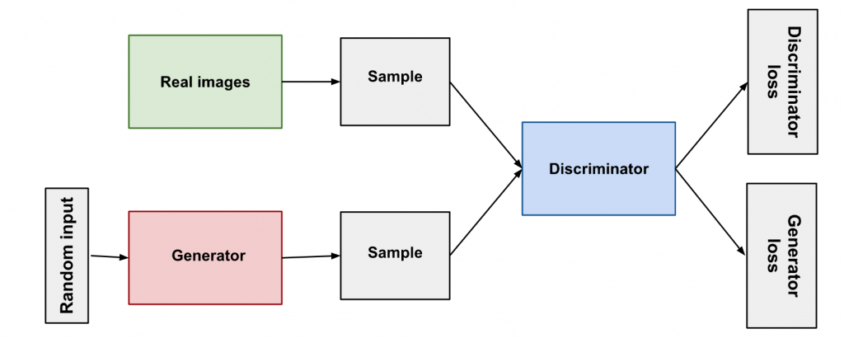
SYSTEM ARCHITECTURE

Slide 7
OBJECTIVE
Improve Accuracy: Develop machine learning models that accurately differentiate between genuine and fake news, minimizing false positives and negatives.
Feature Extraction: Identify and extract relevant features (such as linguistic patterns, sentiment analysis, and metadata) from news articles to help in the classification process.
Real-Time Detection: Create a system that can evaluate news content in real time, flagging potential fake news as soon as it is published or shared online.
Scalability: Build a scalable fake news detection model that can handle large volumes of data from multiple sources, including social media platforms and news websites.
Generalization Across Domains: Ensure that the detection system can generalize to different types of news (political, health, etc.) and various formats (text, images, and videos).
Continuous Learning: Design the model to continuously learn from new data, adapting to emerging trends in fake news tactics and maintaining its effectiveness over time.

Slide 8
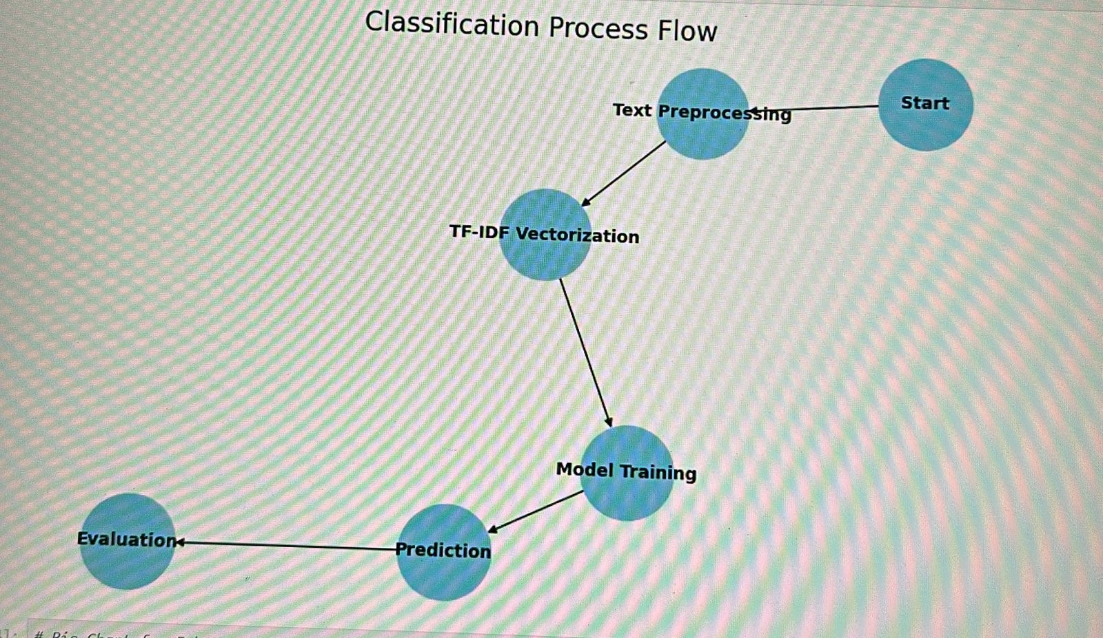
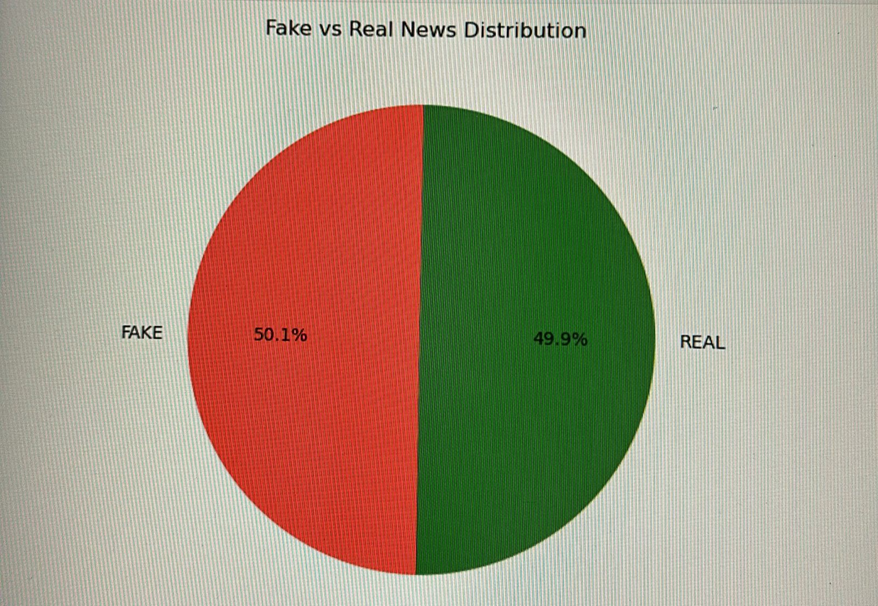
OUTPUTS

Slide 9
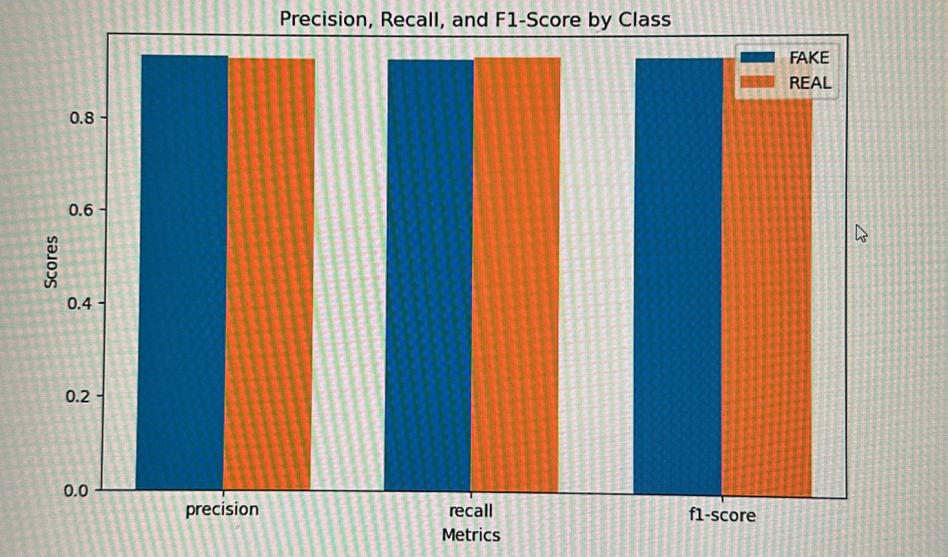
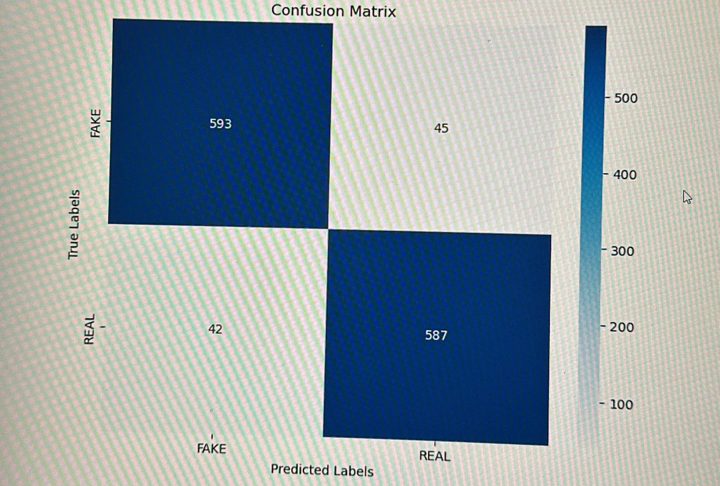

Slide 10
CONCLUSION
In conclusion, the development of a machine learning-based fake news detection system offers a promising solution to combat the spread of misinformation. By leveraging advanced techniques for feature extraction, real-time analysis, and continuous learning, the system can effectively differentiate between credible and deceptive news across diverse platforms and topics. The scalability and adaptability of the model ensure its long-term effectiveness, helping to mitigate the impact of fake news on society and improving the reliability of information sources. Through ongoing improvements and innovation, this technology has the potential to play a crucial role in promoting trust and accuracy in the digital age.

Slide 11
THANK YOU
VAISHNAVI
VARSHA
BENJIMIN

